Slide 1
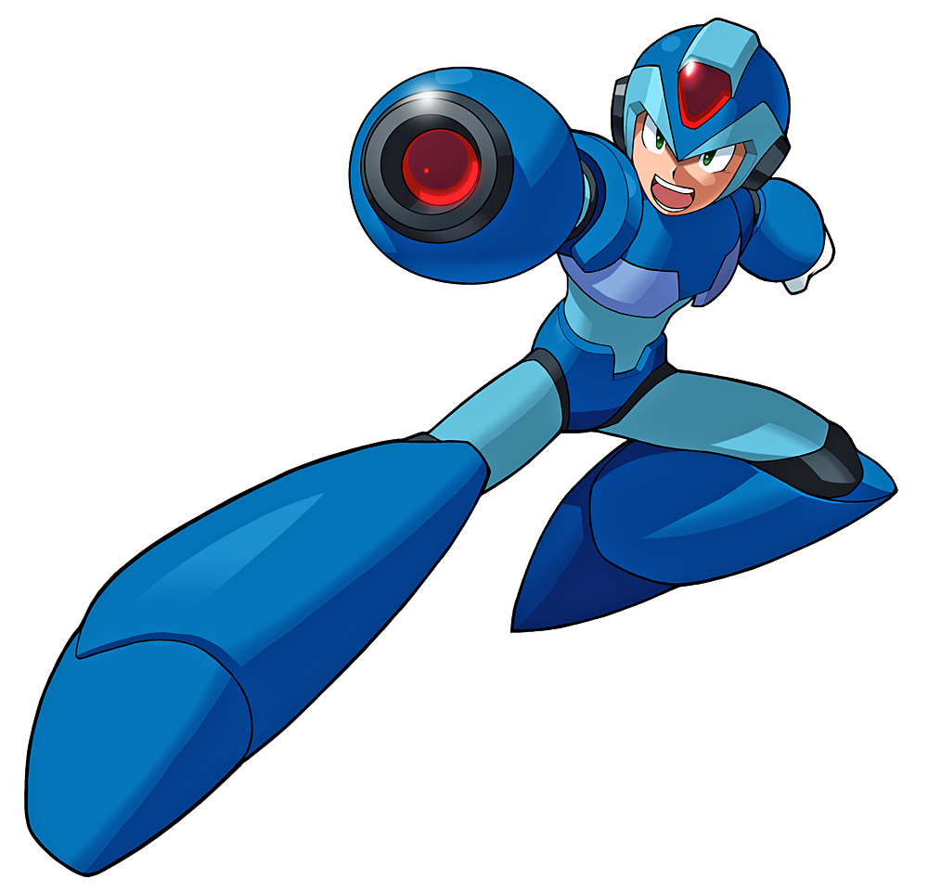
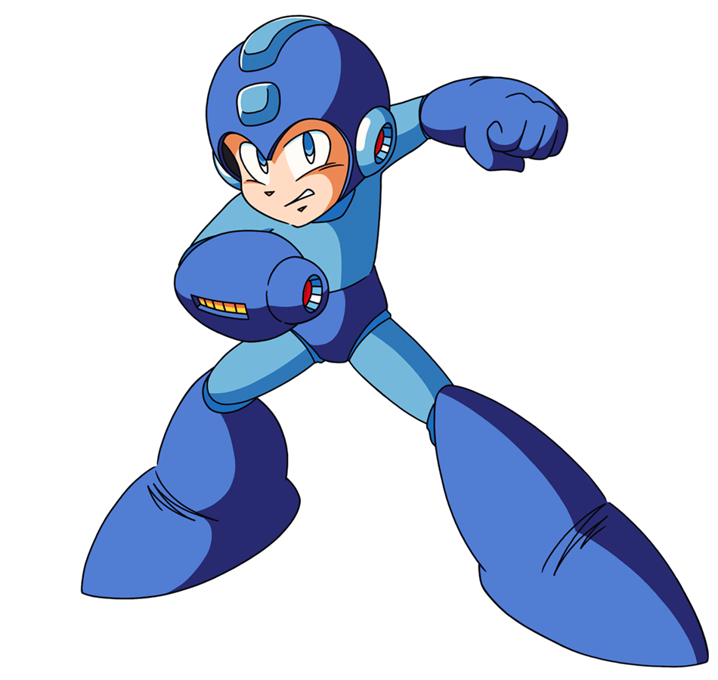
Mega Mania
By Comcap(Pierce Bernard, Chloe Grenade, Matthew Kara, Tristan Santos)

Slide 2
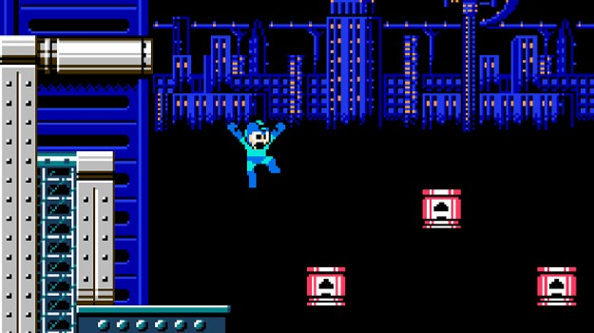
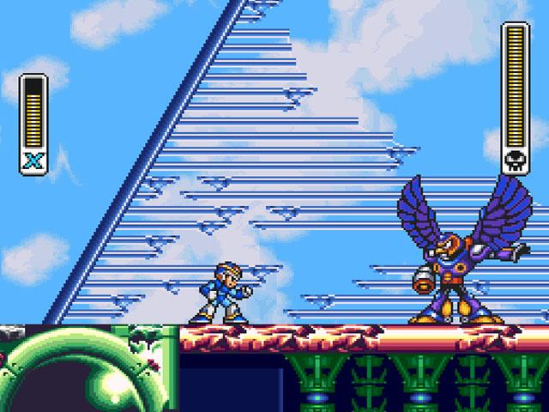
Notes:
The year is 200X, and this marks the day that Rock, also known as MegaMan, had saved his world once again from Dr. Wily’s evil scheme once again. But what the robot didn’t know was of the upcoming threat, a evil robot named Sigma with his 4 Mavericks that have come to team up with Wily to destroy Rock and Dr. Light before Light can have time to make Sigma’s biggest enemy, MegaManX. But what Sigma didn’t expect was for X to follow him back in time to stop his evil plan. Now, both Rock and X have to whatever it takes to save the world from both their respective hardest challenges.Jump and shoot your way through your enemies before facing your biggest challenge yet.

Slide 3
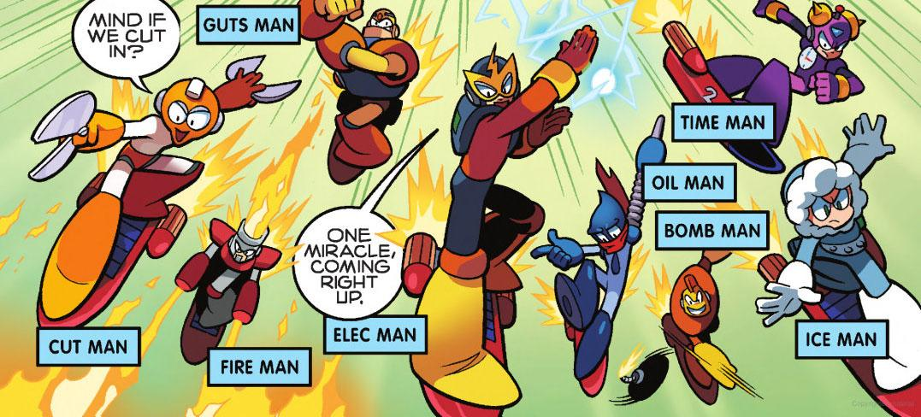

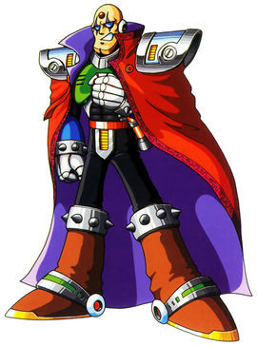

Sigma
Dr. Wily
The 4 Mavericks (Storm Eagle, Boomer Kuwanger, Chill Penguin, Sting Chameleon)
The 4 Robot Masters (Cut-Man,Guts-Man, Fire-Man,Elec-Man)

Slide 4
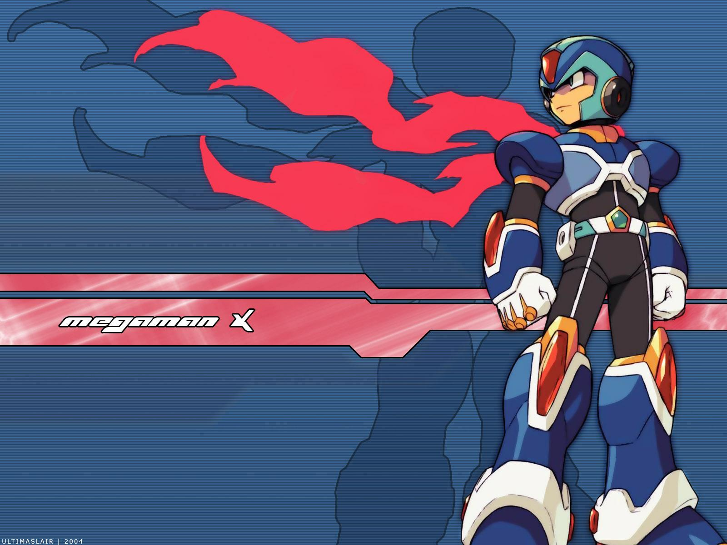
MegaManX, one of the first Reploids made in 20XX to have the power to make their own choice, is the hero of his timeline. Created by Dr. Light, who also made Rock,and finished by Dr. Cain, the creator of all reploids he strives to save his world from Sigma’s tyranny.

Slide 5
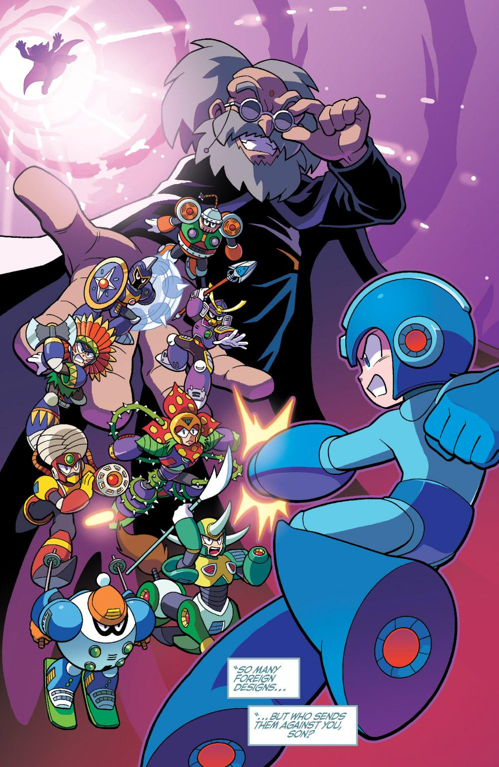
Rock, originally just a regular robot, transformed into MegaMan after Dr. Wily stole Dr. Light’s Robot Masters and corrupted them, leaving Rock to destroy them and stop Wily and his evil plan to take over the world.

Slide 6
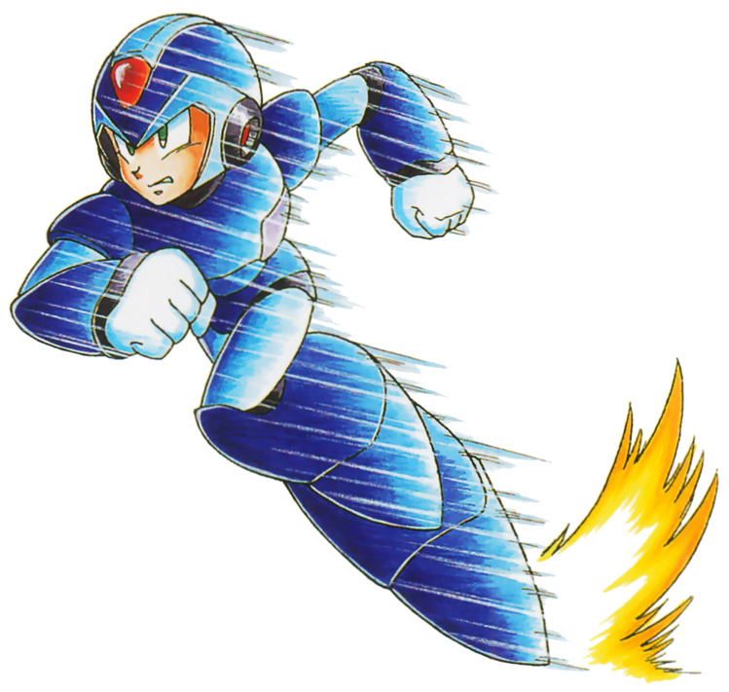

Player interaction -
Forward: D
Backward: A
Crouch: S
Jump: Space
Dash(X Only): L
Forward Shot: K
Backward Shot: J
Charge Shot: K/J (Hold)
Slide(Rock Only): S+K/J

